Slide 1
Episode 2: The Salt Strikes Back
Brian Locke, MD
PGR 5/27/21

Slide 2

On Diuresis
Brian Locke, MD
Review from last time
Net fluid change and Net Sodium change don’t always go in the same direction
Na Balance, rather than fluid balance, is the most important metric of decongestion.
Fluid restrictions are not generally helpful in decongesting patients
‘We’ (inpatient providers) frequently dose Lasix too low, wait too long to increase the dose, and stop diuresing too soon.
PGR 3/4/21
Notes:
Part 2 of

Slide 3
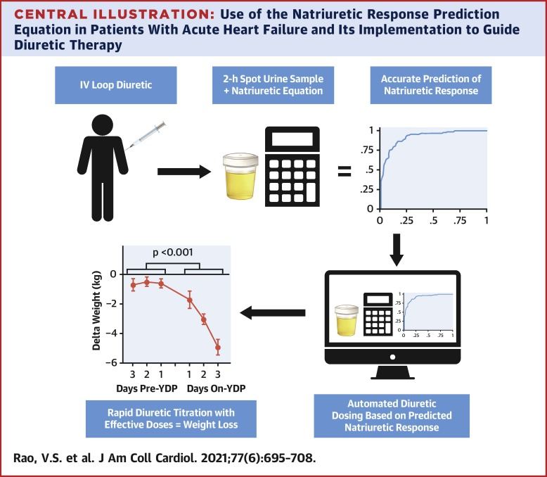
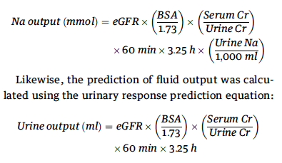
Review: Natriuresis based decongestion
Simple: Spot urine Na > 100 2h after dose = was probably effective (will lead to net 2g+ natriuresis in BID dosing)
Complex:
Notes:
https://pubmed.ncbi.nlm.nih.gov/33573739/

Slide 4
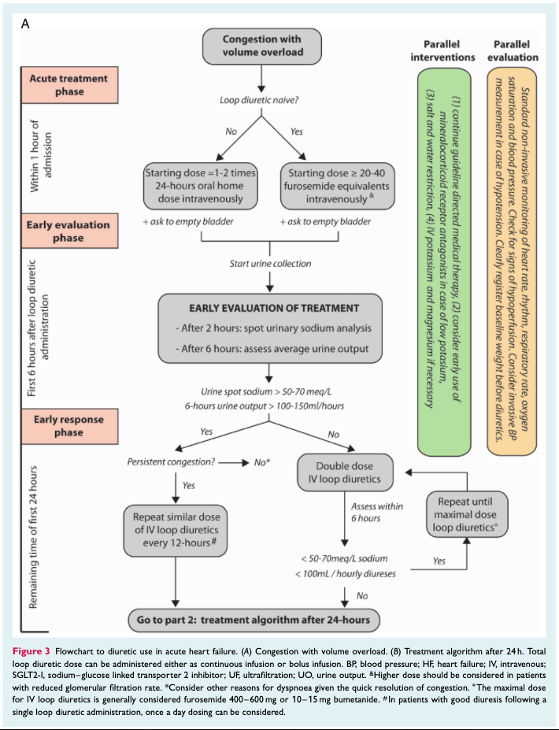
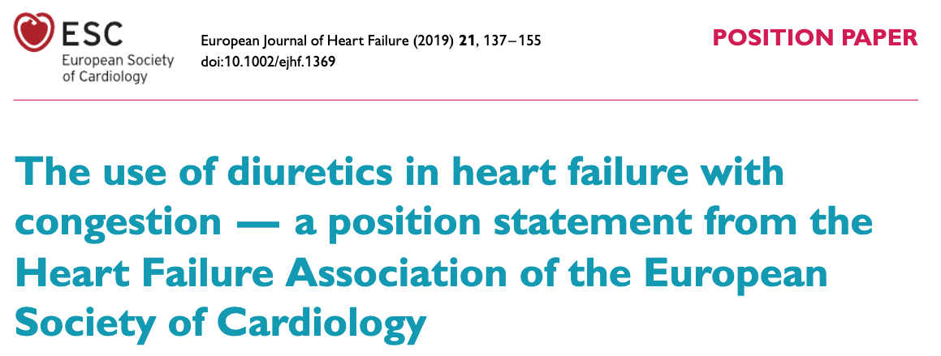
The future is now?

Slide 5
A case, familiar to all:
68M with DM who is admitted to the ICU after a diagnosis of COVID.
His DM is mild (A1c 6.5%), with no nephropathy
He is admitted to the ICU after intubation for respiratory failure.
His initial ventilator oxygenation settings: 50% fiO2 and 12 cmh2o of PEEP but he subsequently worsens to 70% / 14.
Neuromuscular blockade and proning are initiated.
He is receives a 5d course of CTX/azithro. He is euvolemic on admission

Slide 6
A Case, continued
He is difficult to sedate, and thus requires high dose propofol. He develops hyperTG. Switched to lorazepam 2mg q4, Fent 150 mcg/hr and ketamine at 0.4 mg/kg/hr to allow neuromuscular blockade. He is started on a cisatricurium drip 3-4 mcg/kg/min, which he is continued on for 18h per day.
Over the next 3 days, he develops a positive fluid balance. He also worsens to requiring 100% fio2 and 20 PEEP when supine.
I/O: Day 1 proning: 1L positive (mostly NS), Day 2 proning 1L positive (mostly NS), Day 3: 3L positive (enteral free water added)
Notes:
This could have literally been

Slide 7

Bad ARDS Circle of Life
Many Drips
(in NS)
Hypernatremia
Fluid Overload
Lasix & no
free H2O
Notes:
Irreverent
Rubbing salt in the wound

Slide 8
Goal: Explore H2O Balance vs Sodium Balance
Review renal physiology that explains why sodium loading might be problematic
Review data regarding sodium loading and “fluid creep” in the ICU
Discuss clinical implications and strategies to avoid excess sodium
Water
Salt

Slide 9

Molar mass of sodium: 22.99 g/mol = 22.99 g/mEq
Na load in a normal diet (recommended 2.3g = 100 mmol; actual 3.4g = 148 mmol)
Average total osmolar load = 10 mOsm/kg/day => 898 osm (men) and 774 osm (women)
Total water intake 3.46L (men) and 2.75L (women): 3.1L average – roughly 30% from water, 70% from soft drinks and food.
Average [Na] and [osm] of intake: 47 mEq/L of Na, 270 mOsm
Notes:
What’s a normal fluid, osm, and salt intake?
Chloride 35.45
Salt
https://www.fda.gov/food/nutrition-education-resources-materials/sodium-your-diet#:~:text=Americans%20eat%20on%20average%20about,about%201%20teaspoon%20of%20salt!
Water
https://www.cdc.gov/nchs/products/databriefs/db242.htm
Osm
https://thecurbsiders.com/podcast/48-hyponatremia-deconstructed
“1 mmol/L = 1 mOsm/kg. Solute is excreted via urine, which can be diluted to minimum of 50 mmol/L (minimum urinary concentration), or concentrated to maximum 1200 mmol/L (or 1200 mOsm/kg). E.g. 60 kg person ingests about 10 mOsm/kg/day = solute load of 600 mOsm/day that must be excreted”
1 mmol of sodium (Na) = 23 mg Na = 58.4 mg salt (NaCl)

Slide 10
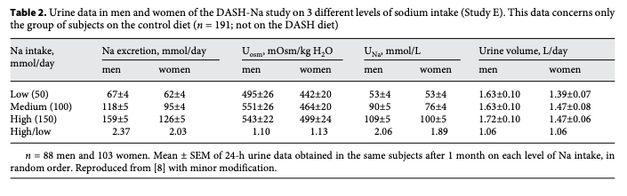
Does someone who eats 2g of Na/d drink the same H2O as someone who eats 4g of Na/d?
Yes – at steady state – in = out.
Over a large range of sodium intake, urine production and thus fluid intake will be constant
More natriuresis occurs in people who eat more salt.
Notes:
[ x ] Bankir L, Perucca J, Norsk P, Bouby N, Damgaard M. Relationship
between sodium intake and water intake: the false and the true. Ann
Nutr Metab. 2017;70(Suppl 1):51–61.

Slide 11
Physiology Review
Large bolus of free water?
ADH shuts off. Kidneys produce dilute urine. Electrolytes and volume status unchanged.
For avg (10 mOsm/kg/day) diet, ADH fully off = 50 mmol/L (maximally dilute) 70 kg person => 700 mmol load => 50 mmol/L excretion => 14L of free water can be excreted per day without perturbing sodium balance.
Large bolus of sodium?
Maximal natriuresis ~280 mmol/L (2x serum, roughly).
Why? There is NO active sodium excretion along the nephron
Notes:
Compare: potassium, urea can concentrate 10-1000x the plasma – partly because serum concentrations of these things are much lower
Threshold of 250-300 mmol per day before U_na alone is not enough to compensate, and V will increase to compensate

Slide 12
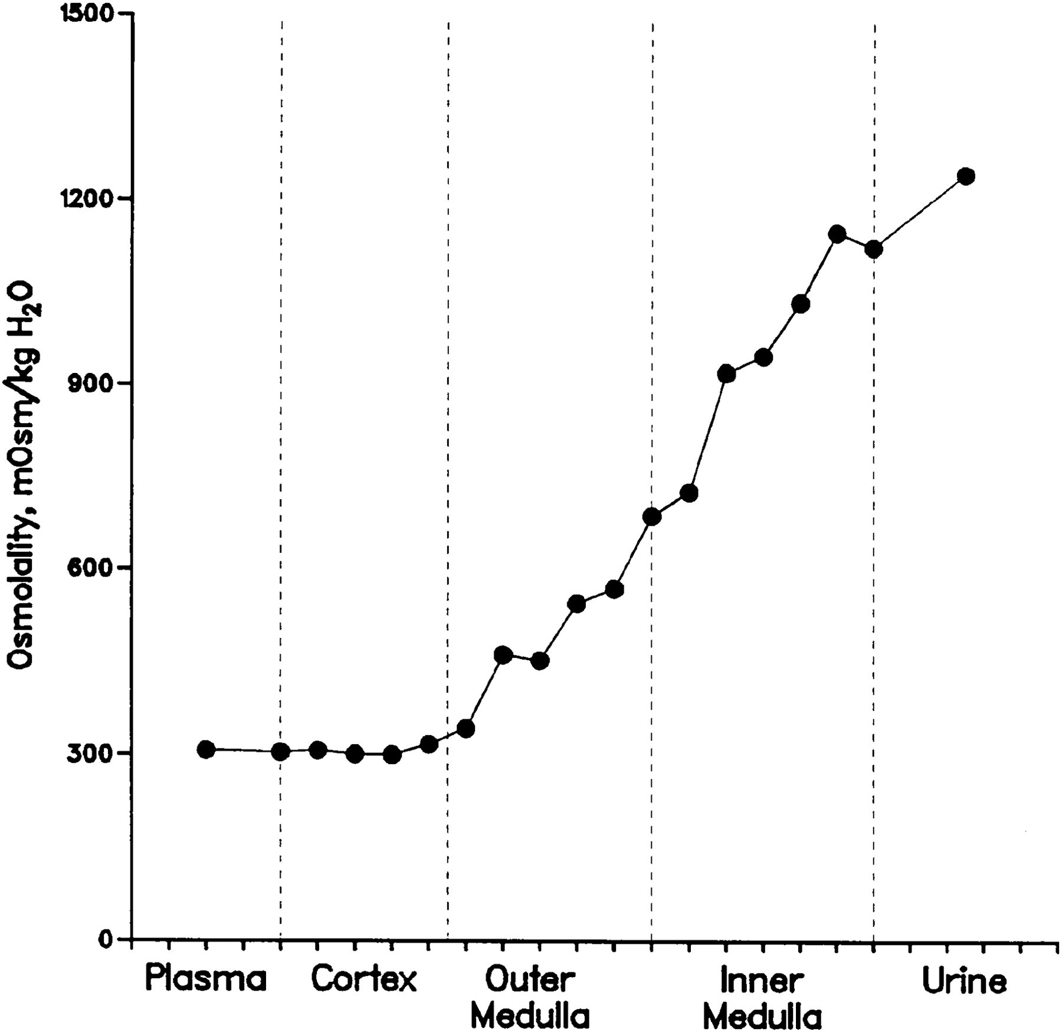
The nephron doesn't have a dedicated method to excrete sodium.
Instead, the kidneys concentrate urine by increasing urea concentration in the medulla.
Counter-intuitively, to maintain osmolality the major mechanism after an ingestion of salt is not thirst, but free water re-absorption in the kidney (ie. concentration of urine)
It takes time to generate this gradient
Kidneys retain water (with ADH) to maintain [Na] in serum in the interim
Glucocorticoid driven catabolism to generate urea
Increase urea in the renal medullary interstitium
Increase osmotic gradient to reabsorb free water
Notes:
Natriuretic peptides: increase GFR, inhibit RAAS – but no active secretion.
Rakova N, Kitada K, Lerchl K, Dahlmann A, Birukov A, Daub S, et al.
Increased salt consumption induces body water conservation and
decreases fluid intake. J Clin Invest. 2017;127(5):1932–43.
24. Kitada K, Daub S, Zhang Y, Klein JD, Nakano D, Pedchenko T, et al. High
salt intake reprioritizes osmolyte and energy metabolism for body fluid
conservation. J Clin Invest. 2017;127(5):1944–59
Yet, they
seem unable to manage an additional sodium load of a
few hundred millimoles above the usual dietary intake.
From an evolutionary viewpoint, however, this makes
perfect sense. Indeed, compared to the risks of dehydration
and sodium loss, sudden (voluntary) peaks in
sodium intake have been a virtually non-existent problem
throughout evolution.
22: Sodium retention = aldosterone mediated fluid retention

Slide 13
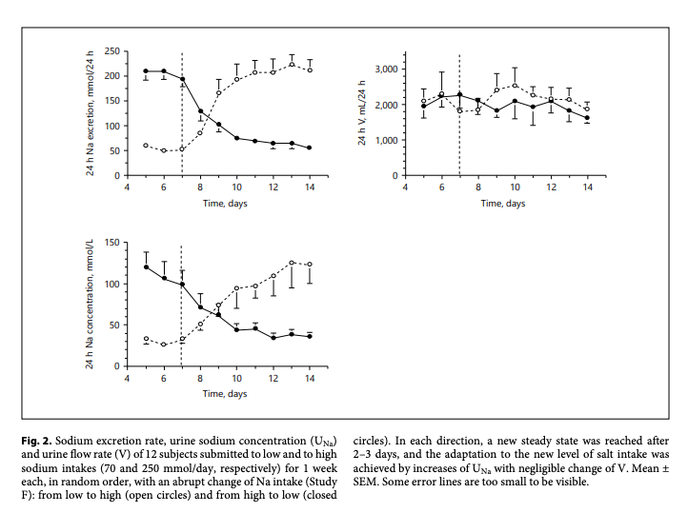
If someone who normally eats low Na diet eats high Na diet, do they drink more water?
Healthy people randomized to either low sodium (0.5 g) to regular (3.2g) diet, then swap
After increased Na load: takes ~3-5 days to reach a new steady state with kidney able to match Na load
On the first day: only half of excess Na load excreted
The positive sodium balance caused fluid retention andan increase in body weight of over 1 kg.
No difference in fluid intake (free-water reabsorption makes up difference)
Notes:
Early L. Clinical disorders of fluid and electrolyte metabolism. New York:
McGraw-Hill; 1972.

Slide 14
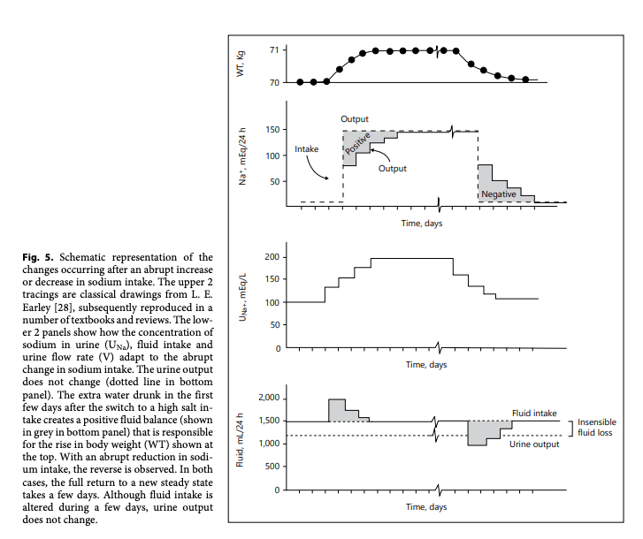
Na and fluid load in this patient
1L of NaCl = 3.5gm (154 mmol Na) = ~7 gm NaCl
Our case:
~750 cc/d NS from Ketamine, 350 cc/d from Fentanyl 100 cc/d ciastricurium, 200 from CTX
~4g of sodium just from sedation and NMB

Slide 15
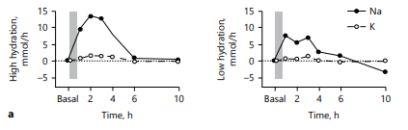
ADH is also a weak Anti-natriuretic Hormone
Healthy volunteers drank either:
Low hydration: free water 0.25 mL/kg q30m (=35 mL/hr for 70kg) or
High hydration: water 2.0 mL/kg q30m (= 288 mL/h for 70kg).
Then received 250cc 2% NaCl
High hydration: excrete the extra sodium immediately.
Low hydration cannot (ADH crosstalk, maximal concentration ability of kidneys)
Meaning: the kidneys CANNOT create low free water, high Na urine
Notes:
Does load patients with sodium then restrict sodium sound familiar?

Slide 16
Physiology in Health Volunteers vs ICU:
Patient characteristics:
Impaired handling of Na in low GFR states, the elderly
Disease characteristics
ATN (less concentration ability)
catabolism (need to excrete solutes)
hyperglycemia (osmotic diuresis)

Slide 17
Physiology Review:
The kidneys have mechanisms to quickly adjust free water clearance.
The kidney does not have a fast mechanism to increase natriuresis – it takes several days and catabolism to achieve this.
Limitation in free water hampers natriuresis due to ADH crosstalk.
While the kidney is adapting to a new baseline sodium intake, fluid retention occurs.
Therefore, it is very hard to achieve balanced I/O during salt loading

Slide 18
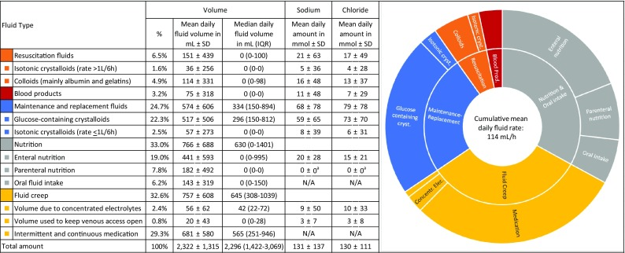
Na loading in the ICU
Fluid creep: fluids administered as vehicle for medication, TKO
Antwerp hospital Belgium 2007-2016, mixed ICU (45 bed)
14650 patients, 103098 patient days
Notes:
Van Regenmortel N, Verbrugghe W, Roelant E, Van den Wyngaert T,
Jorens PG. Maintenance fluid therapy and fluid creep impose more
significant fluid, sodium, and chloride burdens than resuscitation fluids
in critically ill patients: a retrospective study in a tertiary mixed ICU
population. Intensive Care Med. 2018;44(4):409–17
A second major—this time unintentional—source
of sodium in the hospital is the custom of dissolving
medications in NaCl 0.9% to enable intravenous administration.
Bihari et al. demonstrated that drug boluses
accounted for 12.3% of total sodium administration and
drug infusions for 8.6%

Slide 19
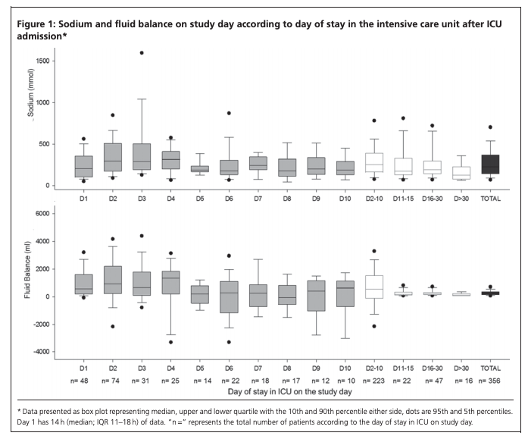
Single-day, point prevalence survey: 46 Australian and New Zealand ICUs on 21 September 2011
Median sodium admin: 224.5 mmol (IQR, 144.9-367.6 mmol). 2.8 mmol/kg (IQR, 1.6-4.7 mmol/kg).
Patients Day 2-10 of ICU admission:
maintenance or replacement intravenous (IV) infusions, 69.3mmol; 30.9% of all sodium sources;
IV fluid boluses, 36.5 mmol; 16.3%;
IV drug boluses, 27.6 mmol; 12.3%;
enteral nutrition, 26.5 mmol; 11.8%;
IV drug infusions, 19.3 mmol; 8.6%;
IV flushes, 16.6mmol; 7.4%;
blood products, 13.5 mmol; 6%;
IV antimicrobials, 11.2mmol; 5%;
parenteral nutrition, 4.3 mmol; 1.9%.
Median = 5 grams of Na per day
Double the usual intake
Notes:
George Institute for Global H, Bihari S, Peake SL, Seppelt I, Williams P,
Bersten A, et al. Sodium administration in critically ill patients in Australia
and New Zealand: a multicentre point prevalence study. Crit Care
Resusc. 2013;15(4):294–300.
A prospective
single-day point prevalence survey, conducted in 46 Australian
and New Zealand ICUs, demonstrated that maintenance
and replacement fluids are responsible for 30.9%
of the total daily sodium administration of 220 mmol
(5 g) and—contrary to common belief—a much more significant
source of sodium than resuscitation fluids

Slide 20
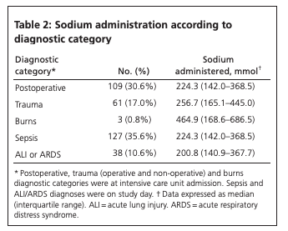
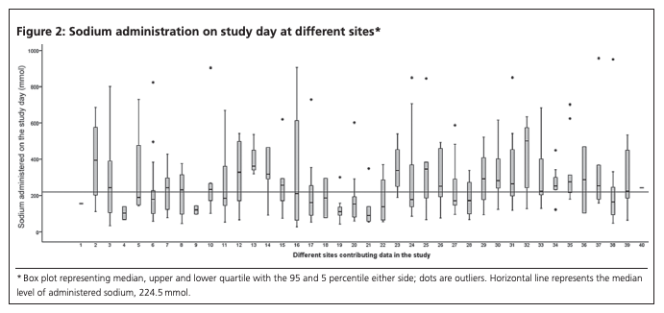

Slide 21
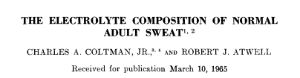
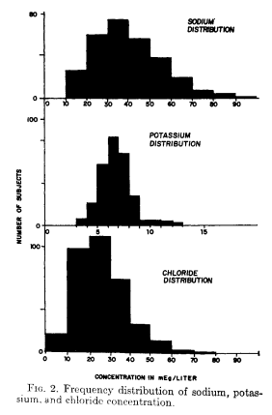
What is the composition of insensible losses?
Estimated: 600—900 mL per day
Respiration: [Na] = 0
Perspiration: [Na] = 40.1 mEq per L
Stool? 250 mL per day, but huge variation in composition and volume of losses depending on pathology.

Slide 22
Clinical impact
Malbrain 2014 meta-analysis: “A restrictive fluid management was associated with a lower mortality compared to patients treated with a more liberal fluid management strategy (24.7% vs 33.2%; OR, 0.42; 95% CI 0.32-0.55; P < 0.0001)”

Slide 23
To be considered for additional fluids, you generally are not improving
The group who receives large volumes of fluid has been doing bad enough (despite other interventions) at each time point when fluids are considered and is thus not comparable to the group that did not receive fluids (who could either be doing badly and not received fluids – the intended comparator – or have responded to other treatment
Analogous to immortal time bias: patients who are responding to current therapy are generally not considered for additional fluid boluses.

Slide 24
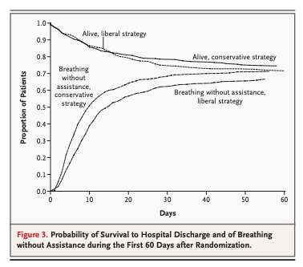
Clinical impact - FACTT / FACTT Lite
RCT comparison of fluid management strategy to target CVP 10-14 (liberal) vs CVP < 4 (conservative) in ARDS
Improved oxygenation, decreased days on ventilator, decreased time in ICU
Takeaway: avoiding congestion is important in these patients

Slide 25
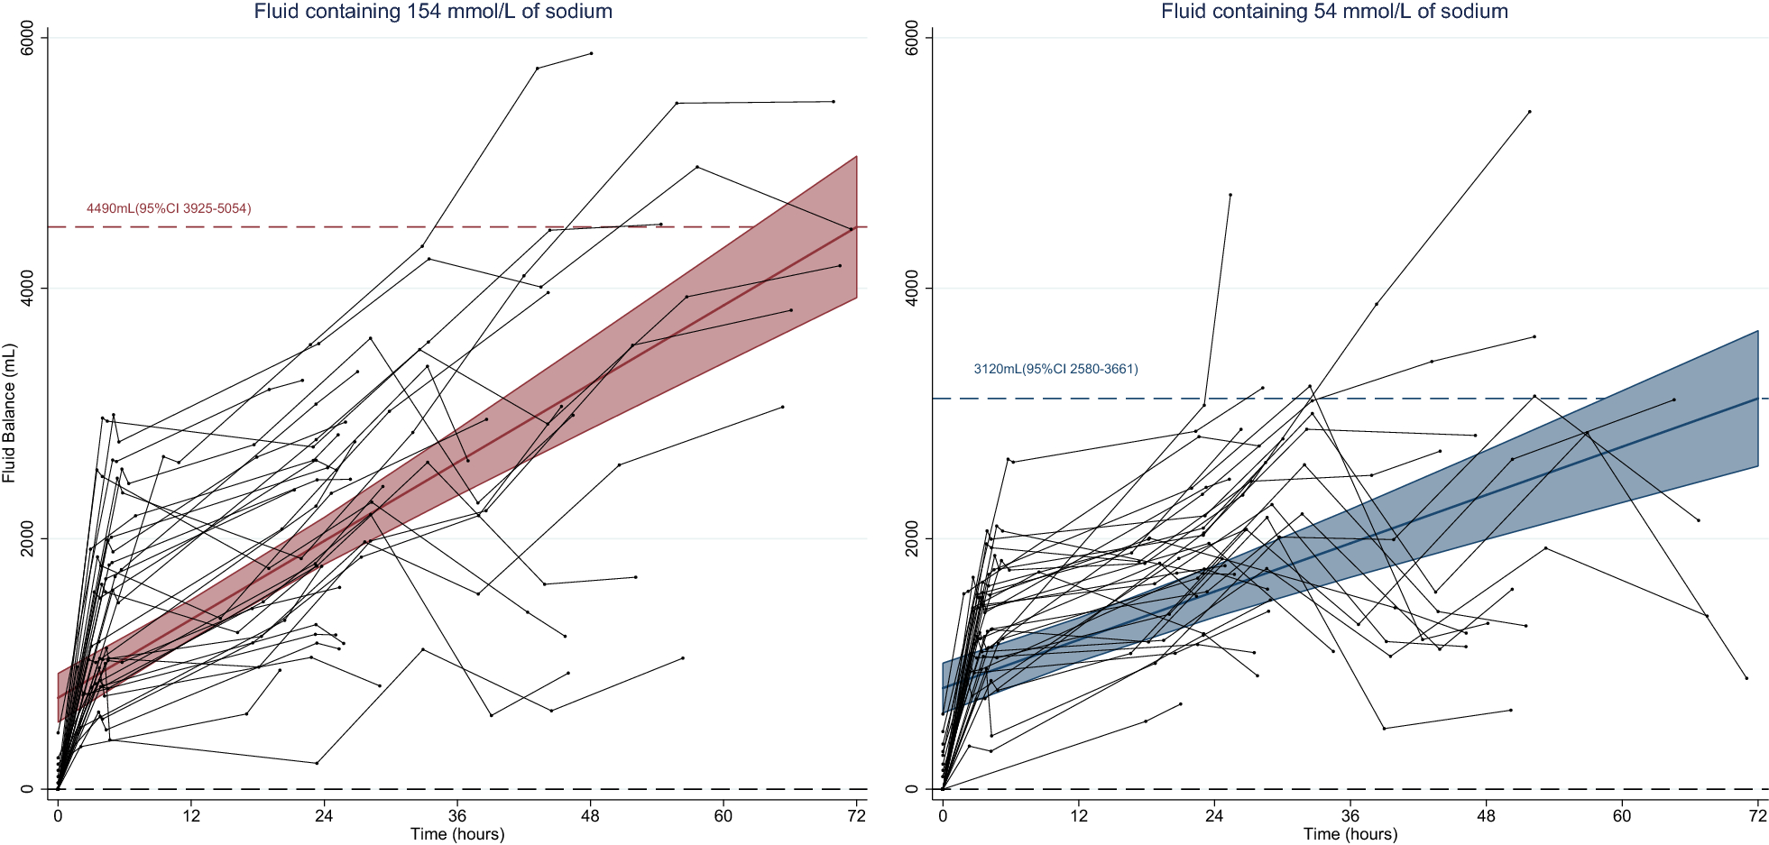
Clinical impact - TOPMAST trial
Blind randomization of 70 patients undergoing major thoracic surgery to [Na] = 154 mmol/L vs [Na] = 54 mmol/L fluid
Primary: Net fluid balance: Na154 = +4.5L vs Na54 = 3.12L despite identical fluid infused
Secondary:
Pulmonary Edema: Na154 = 17%, Na54 = 3%
Electrolyte abnormalities:
Na154 – n=3 had Na above 145.
N=24 had Cl- above ULN
Na54 – n=4 patients had Na
below 135.
Notes:
The composition of the study solution was thus responsible for an additional fluid retention of 22% (95% CI 10–34%) of its infused volume.

Slide 26
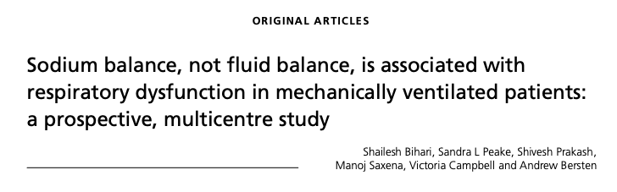
Prospective, observational study of N=50 ventilated patients
Tracked net fluid (mean +2.6L) and net sodium balance (mean 717 mmol)
Positive cumulative sodium balance: correlated ro -0.36, p=0.0001 with worsening next sodium P:F
Positive fluid balance: no correlation ro 0.1, p=0.23 with worsening next day P:F
Notes:
Bihari S, Peake SL, Prakash S, Saxena M, Campbell V, Bersten A. Sodium
balance, not fluid balance, is associated with respiratory dysfunction in
mechanically ventilated patients: a prospective, multicentre study. Crit
Care Resusc. 2015;17(1):23–8.

Slide 27
What to do to avoid this? Na Stewardship
Don’t use maintenance fluids (duh).
Avoid sodium in fluid creep
Keep track of Na in
Maybe someday we’ll track Na output?
Give some free water
Diurese (Natriurese) your patients? (Maybe add a thiazide)
Notes:
Whats going on with the Orme approach?
Decrease Na intake to near 0
Wait

Slide 28
Why do we dissolve medications in NaCl?
ICUs have pre-mixed versions of medications to deliver quickly (ie. antibiotics, fentanyl)
Some meds are sodium salts (= any negative ion paired with a sodium cation) – generally more soluble in water than the acid form
A few medications must be given in NS
It’s the default

Slide 29
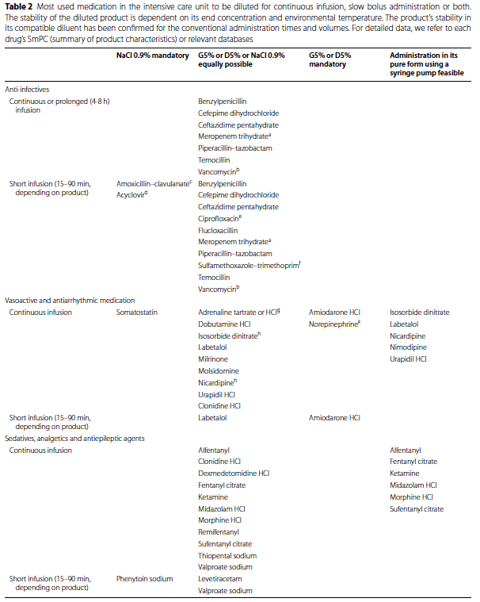
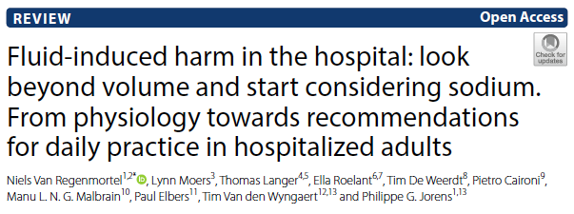
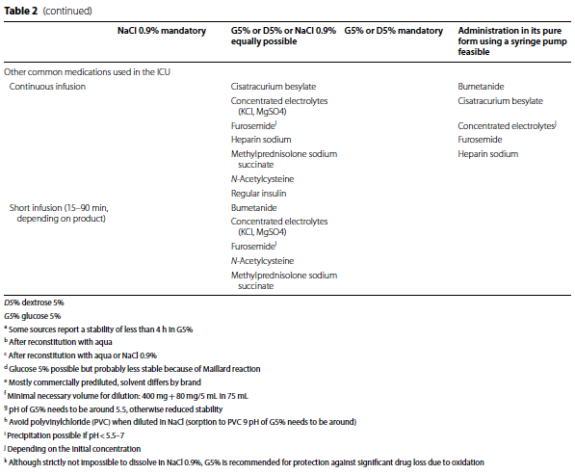

Slide 30
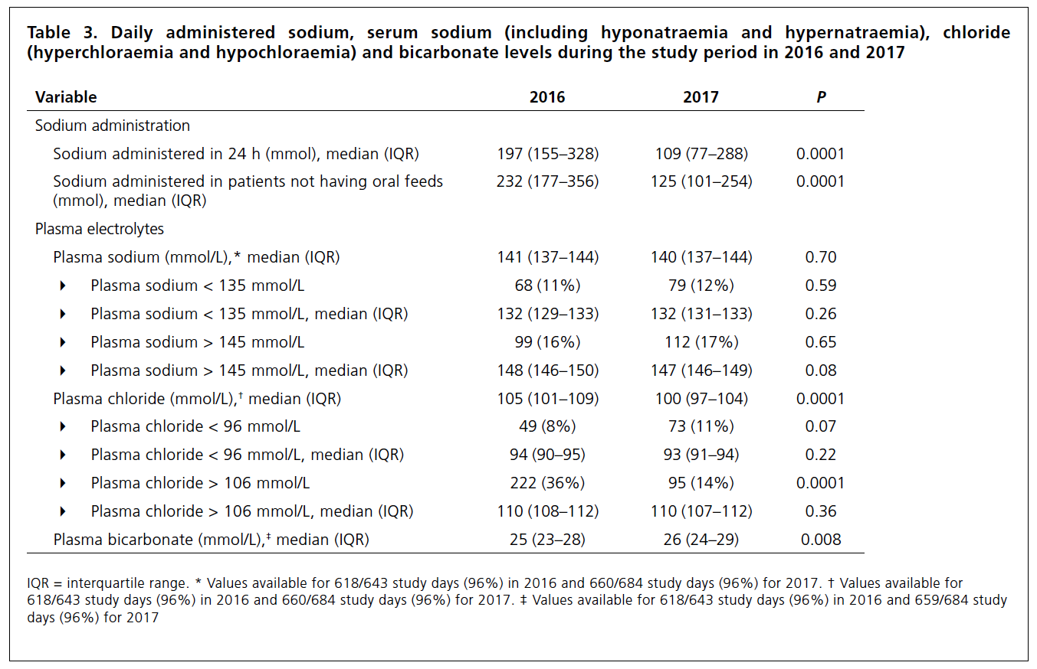
Before-after Australian ICU: D5W as default
Notes:
Bihari, S., Prakash, S., Potts, S., Matheson, E. and Bersten, A.D., 2018. Addressing the inadvertent sodium and chloride burden in critically ill patients: a prospective before-and-after study in a tertiary mixed intensive care unit population. Critical Care and Resuscitation, 20(4), p.285.

Slide 31
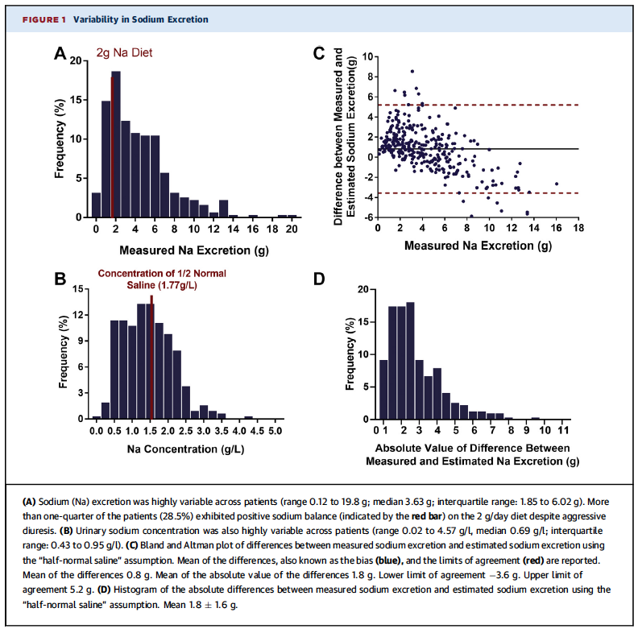
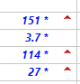
Can’t we just add furosemide
Notes:
Problem: Tonicity of urine with treatment with loop diuretics is hypotonic.
In particular, the patients who are fluid restricted are likely to make urine that is hypotonic relative to their inputs (mostly NS, usually), and thus increase serum Na
[ ] add picture of high Na

Slide 32
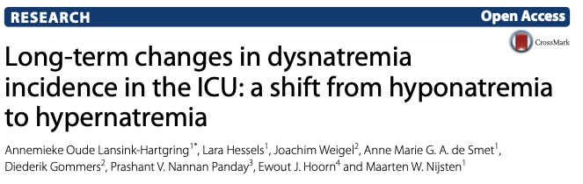
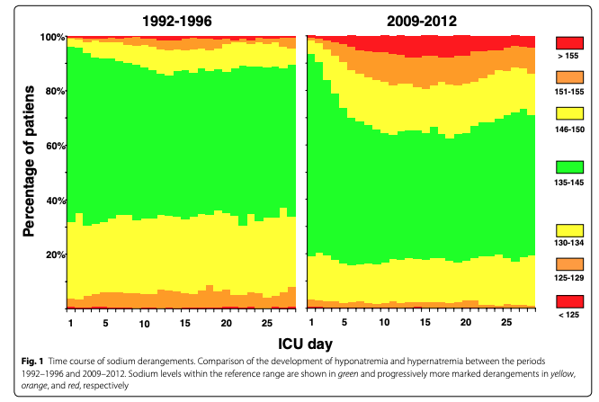
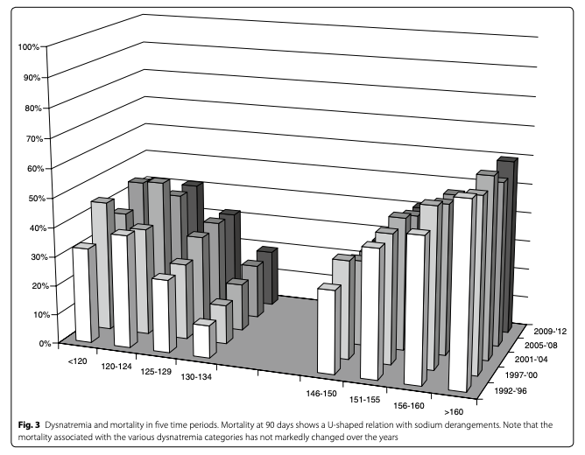
Is this a problem?
Notes:
Oude Lansink-Hartgring A, Hessels L, Weigel J, de Smet A, Gommers D,
Panday PVN, et al. Long-term changes in dysnatremia incidence in the
ICU: a shift from hyponatremia to hypernatremia. Ann Intensive Care.
2016;6(1):22.
As we’ve become more stringent with our I/O tracking, we’ve introduced more dislipidemia

Slide 33
Case Resolution
Diuresed, got hypernatremic, slowly improved over the following week with decreased Na inputs. Extubated this morning. Developed pseudomonas VAP and remains intubated.

Slide 34
Summary Points
Ease up on free water, clamp down on Na load
I/Os (any mL in is equivalent to any other mL in) mislead us – because the kidneys are very good at handling changes in free water intake, not good at handling boluses of sodium
Using D5w instead of NaCl should probably be our default on patients who have large medication intakes (e.g. on cis, fentanyl, ketamine, antibiotics)

Slide 35
Bad ARDS Circle of Life
Use D5W instead
Many Drips
(in NS)
Driven By Na Overload
Hypernatremia
Fluid Overload
Lasix & no
free H2O
Liberal free water can allow natriuresis
Notes:
Irreverent
Rubbing salt in the wound

Slide 36
Take this all with… a grain of salt:
Van Regenmortel, N., Moers, L., Langer, T., Roelant, E., De Weerdt, T., Caironi, P., Malbrain, M.L., Elbers, P., Van den Wyngaert, T. and Jorens, P.G., 2021. Fluid-induced harm in the hospital: look beyond volume and start considering sodium. From physiology towards recommendations for daily practice in hospitalized adults. Annals of Intensive Care, 11(1), pp.1-12.
Bankir L, Perucca J, Norsk P, Bouby N, Damgaard M. Relationship between sodium intake and water intake: the false and the true. Ann Nutr Metab. 2017;70(Suppl 1):51–61.
Van Regenmortel N, Verbrugghe W, Roelant E, Van den Wyngaert T, Jorens PG. Maintenance fluid therapy and fluid creep impose more significant fluid, sodium, and chloride burdens than resuscitation fluids in critically ill patients: a retrospective study in a tertiary mixed ICU population. Intensive Care Med. 2018;44(4):409–17
George Institute for Global H, Bihari S, Peake SL, Seppelt I, Williams P, Bersten A, et al. Sodium administration in critically ill patients in Australia and New Zealand: a multicentre point prevalence study. Crit Care Resusc. 2013;15(4):294–300.
Van Regenmortel, N., Hendrickx, S., Roelant, E., Baar, I., Dams, K., Van Vlimmeren, K., Embrecht, B., Wittock, A., Hendriks, J.M., Lauwers, P. and Van Schil, P.E., 2019. 154 compared to 54 mmol per liter of sodium in intravenous maintenance fluid therapy for adult patients undergoing major thoracic surgery (TOPMAST): a single-center randomized controlled double-blind trial. Intensive care medicine, 45(10), pp.1422-1432.
Bihari S, Peake SL, Prakash S, Saxena M, Campbell V, Bersten A. Sodium balance, not fluid balance, is associated with respiratory dysfunction in mechanically ventilated patients: a prospective, multicentre study. Crit Care Resusc. 2015;17(1):23–8.
Lansink-Hartgring, A.O., Hessels, L., Weigel, J., de Smet, A.M.G., Gommers, D., Panday, P.V.N., Hoorn, E.J. and Nijsten, M.W., 2016. Long-term changes in dysnatremia incidence in the ICU: a shift from hyponatremia to hypernatremia. Annals of intensive care, 6(1), pp.1-8.
Bihari, S., Prakash, S., Potts, S., Matheson, E. and Bersten, A.D., 2018. Addressing the inadvertent sodium and chloride burden in critically ill patients: a prospective before-and-after study in a tertiary mixed intensive care unit population. Critical Care and Resuscitation, 20(4), p.285.

